Slide 1


Types of Waves, Sinusoidal Waves, Wavelength and Frequency
Chapter 16:Waves—I

Slide 2
Chapter 16. Wave I
16.1. What is Physics?
16.2. Types of Waves
16.3. Transverse and Longitudinal Waves
16.4. Wavelength and Frequency
16.5. The Speed of a Traveling Wave
16.7. Energy and Power of a Wave Traveling Along a String
16.9. The Principle of Superposition for Waves
16.10. Interference of Waves
16.12. Standing Waves
16.13. Standing Waves and Resonance

Slide 3
What is Physics?

Slide 4
Types of Waves
Mechanical waves.
Electromagnetic waves.
Matter waves.

Slide 5
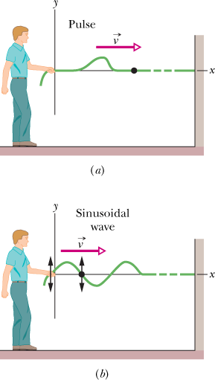
Transverse Wave
the displacement of every such oscillating string element is perpendicular to the direction of travel of the wave. This motion is said to be transverse, and the wave is said to be a transverse wave.

Slide 6
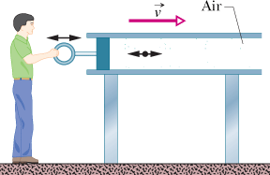
Longitudinal Waves
The motion of the elements of air is paralle to the direction of the wave’s travel, the motion is said to be longitudinal, and the wave is said to be a longitudinal wave.

Slide 7
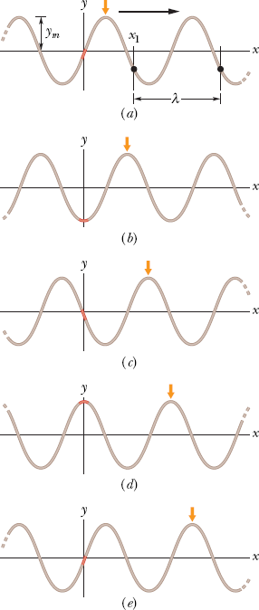
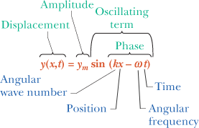
Description of a wave

Slide 8
Wavelength and Angular Wave Number
The wavelength of a wave is the distance (parallel to the direction of the wave’s travel) between repetitions of the shape of the wave (or wave shape)
the angular wave number of the wave

Slide 9
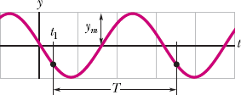
Period, Angular Frequency, and Frequency
the period of oscillation T of a wave to be the time any string element takes to move through one full oscillation.
Angular frequency is
The frequency f of a wave is defined as 1/T and is related to the angular frequency by

Slide 10
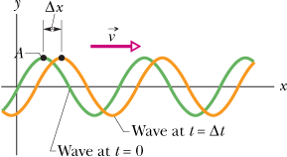
The Speed of a Traveling Wave
the wave speed as

Slide 11
Checkpoint
Here are the equations of three waves. Rank the waves according to their (a) wave speed and (b) maximum speed perpendicular to the wave’s direction of travel (the transverse speed), greatest first.
(1)
(2)
(3)

Slide 12
Sample Problem
A wave traveling along a string is described by
in which the numerical constants are in SI units (0.00327 m,72.1 rad/m, and 2.72 rad/s).
What is the amplitude of this wave?
What are the wavelength, period, and frequency of this wave?

Slide 13
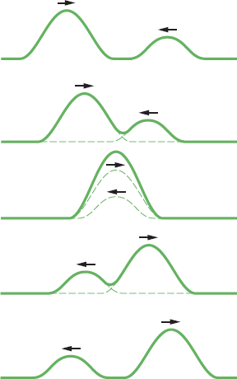
The Principle of Superposition for Waves
Overlapping waves algebraically add to produce a resultant wave (or net wave).
Overlapping waves do not in any way alter the travel of each other.

Slide 14
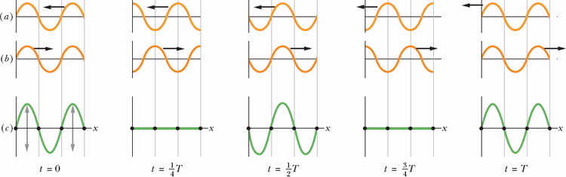
Standing Waves
If two sinusoidal waves of the same amplitude and wavelength travel in opposite directions along a stretched string, their interference with each other produces a standing wave.
Applying the trigonometric relation of Eq. 16-50 leads to
Applying the trigonometric relation of Eq. 16-50 leads to

Slide 15
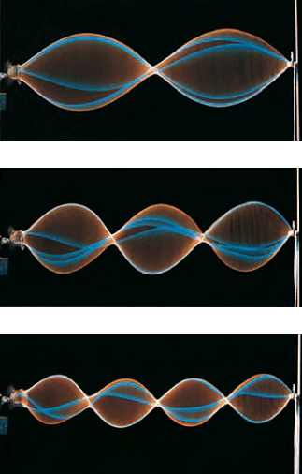
Feature of Standing Wave
The nodes, are places along the string where the string never moves. antinodes are halfway between adjacent nodes where the amplitude of the resultant wave is a maximum.

Slide 16
Standing Waves
In a traveling sinusoidal wave, the amplitude of the wave is the same for all string elements. That is not true for a standing wave, in which the amplitude varies with position.
Applying the trigonometric relation of Eq. 16-50 leads to
Applying the trigonometric relation of Eq. 16-50 leads to

Slide 17
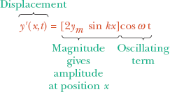


Slide 18
Checkpoint 5
Two waves with the same amplitude and wavelength interfere in three different situations to produce resultant waves with the following equations. In which situation are the two combining waves traveling (a) toward positive x, (b) toward negative x, and (c) in opposite directions?

Slide 19
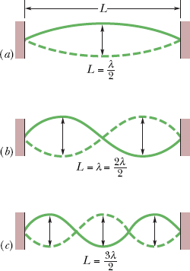
Standing Waves and Resonance
For certain frequencies, the interference produces a standing wave pattern (or oscillation mode) Such a standing wave is said to be produced at resonance, and the string is said to resonate at these certain frequencies, called resonant frequencies.

Slide 20
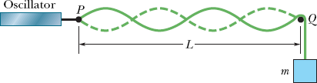
Example
In Fig. 16-44, a string, tied to a sinusoidal oscillator at P and running over a support at Q, is stretched by a block of mass m. Separation L=1.2m, linear density μ=1.6g/m, and the oscillator frequency f=120Hz. The amplitude of the motion at P is small enough for that point to be considered a node. A node also exists at Q. (a) What mass m allows the oscillator to set up the fourth harmonic on the string? (b) What standing wave mode, if any, can be set up if m=1.0kg?
,

